Slide 1
Application Modernization
Building the foundation for a resilient, future ready business

Slide 2



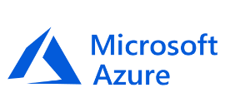
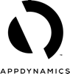
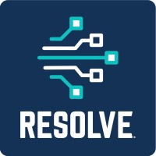

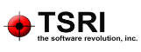

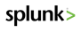





Enterprise Engineering | Integrated offering model
Our model focuses on enabling customers to modernize, build, and manage their Application Estate at Scale
Enterprise Modernization Strategy
Customer Themes
Enterprise Mod Strategy
Cloud Migration Strategy
IT Cost Optimization/Automation
Business Outcome Modeling
Drive Digital Strategy and Business Relevance
Application Modernization
Enterprise Application Development
Application Management
Enable digital transformation with predictable outcomes
Smart DevOps driven Rapid Application development
Industrialization at Scale to design & deliver for Zero Maintenance
Sub-offerings
App Led Cloud Migration
Legacy Modernization
Technology Stack Modernization
Sub-offerings
Platform Driven Smart Development
Citizen development
Cloud Native Development
Sub-offerings
Platform led Application Maintenance
Debt and Automation as-a-service
SRE Transformation
Business driven Modernization
Outcomes
Increased revenue / Modernize margins
New business products / New business models
Insight driven business
Modern enterprise technology stack
Outcomes
Product mindset
Accelerated digital strategy
2-3x improvement in Time to Market
Enable new WFA - modern team, processes, and tools
Outcomes
Opex optimization and IT landscape simplification
Self-fund modernization capex
Improvement in customer / end user experience
Secure and reliable digital landscape
Cognizant Intelligent Engineering | Our ‘Platform-first’ approach
Modernize⁺ - C-MAP | C-CAP
Build⁺ - LEAP | OneDevOps
Manage⁺ - AppLens® | Cognizant Automation Center
Strategic Partners

Slide 3


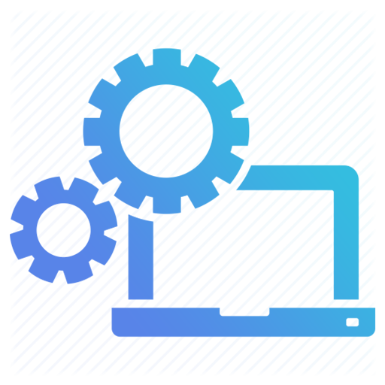



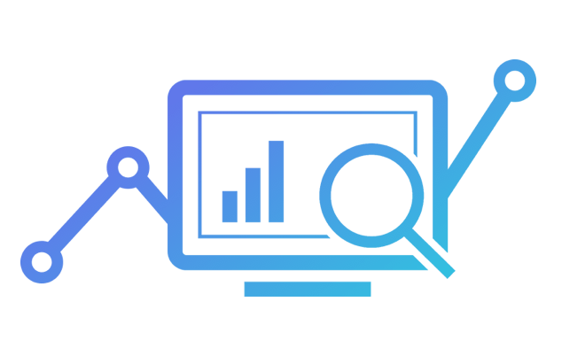

Our dual approach for Application Modernization
Trigger / Symptoms
Characteristics
Cognizant IP / Platform driven approach
Obsolete Technology
CMI (Contain – Maintain – Invest)
6R Treatment Strategy
Cloud Readiness Assessment
Business Agility at the front
Business KPI Driven
Cloud Intrinsic
End user experience centric
Modular / Easy to integrate
Tech Architecture oriented approach
IT Performance Calibration
Capacity / Scalability Planning
Debt-free Apps
Unsupported Tech versions
Application Driven
Cognizant Intelligent Engineering |
Modernize⁺
Monolithic Architecture
Cognizant Modernization Acceleration Platform (C-MAP) and Cognizant Cloud Acceleration Platform (C-CAP) discover App Mod opportunities & recommends the treatment strategy
End User experience Patterns
DFD (Digital Footprint Diagnostics)
Cognizant AppLens® CVM Survey
Business Process latency
Business Value Management (BVM)
Customer Value Management (CVM)
Business
Driven
Use of DFD on business processes to discover the bottlenecks to be optimized and opportunities to be leveraged
Maps the Customer journey based on individual persona score and provide recommendation to improve Customer Experience Index
Business transactions bottlenecks

Slide 4



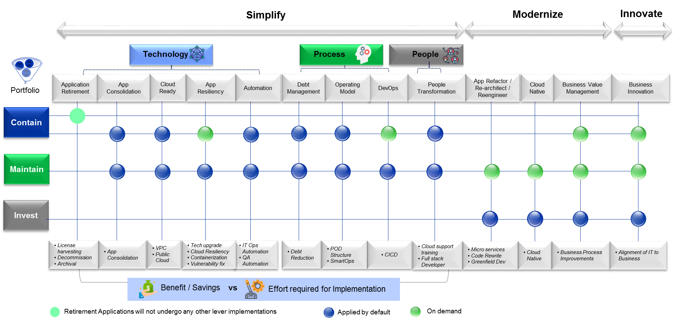
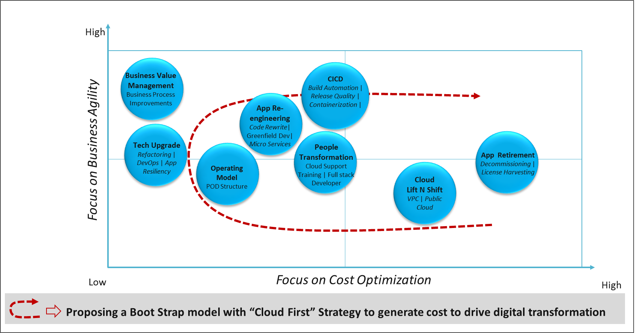
App driven modernization orchestrated through a tiered application strategy
Application Transformation approach
Assess
Strategize Treatment
Implement
Perform Application portfolio analysis to categorize application
Identify levers focusing on Simplifying and Modernizing the applications
Follow “Boot Strap” model to sequence the implementation
Contain
Maintain
Invest
Treatment strategy across application categories
Boot Strap model
Orchestrated through Cognizant Intelligent Engineering | Modernize⁺
Notes:
Modernization Points –
Cloud based modernization including cloud native development are the biggest bets today and growing at 22.8% CAGR
Today, 76% of North American and European enterprise decision makers consider migrating existing apps to the cloud as part of their cloud strategy - Forrester
By 2023, application services spending driven by digital requirements will account for 65% of the overall application services market, up from 30% in 2018 - Gartner
By 2021, 65% of CIOs will expand agile/DevOps practices into the wider business to achieve the velocity necessary for innovation, execution, and change – IDC
By 2023, 40% of application modernization work will be contracted under a multiyear AMS deal - Gartner

Slide 5



Business driven Modernization through business analytics
Modernize applications, platforms and ecosystems by aligning with business objectives & transform valuable business capabilities
Define
Calibrate
Deliver
Recommend
Business Pain Points
Biz. Outcomes & Benchmarks
Service Tree Mapping
Digital Footprint Diagnostics
Validate Design & Coding
Modernization + Cloud Suitability
Biz. Reference Study
Modernization Roadmap
Business Health Dashboard
Business Objectives aligned App/Tech Modernization
Reference list of Key KPIs by business service and by industry with their benchmarks
Industry Benchmarks
‘Value-centric’ Modernization drivers
Business Outcomes
Business Resiliency
Business Performance
Business Agility
User Experience
Analyze business Transaction data generated by the business process in consideration
Digital Footprint Diagnostics (DFD)
Cost Optimization
Future Tech Adoption
Operational Advantages
Risk & Security
Business Process
Continuous Modernization
Process maps across industry
Business Reference Blueprint
Continuous Modernization
Technology
Software
Improves Customer Experience Index
Hardware
Customer Value Management (CVM)
Continuous Modernization

Slide 6
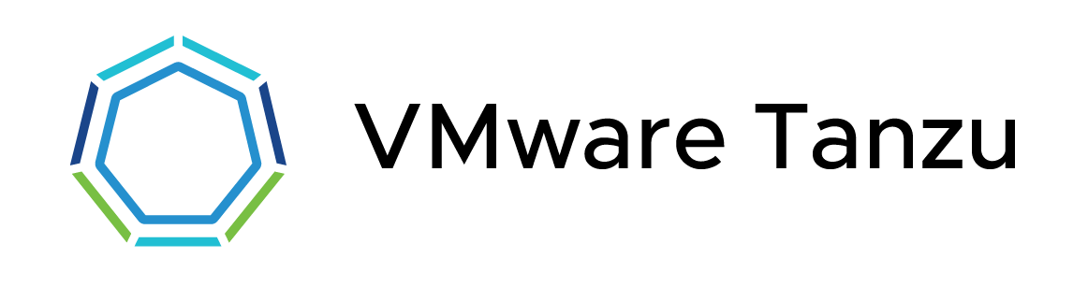
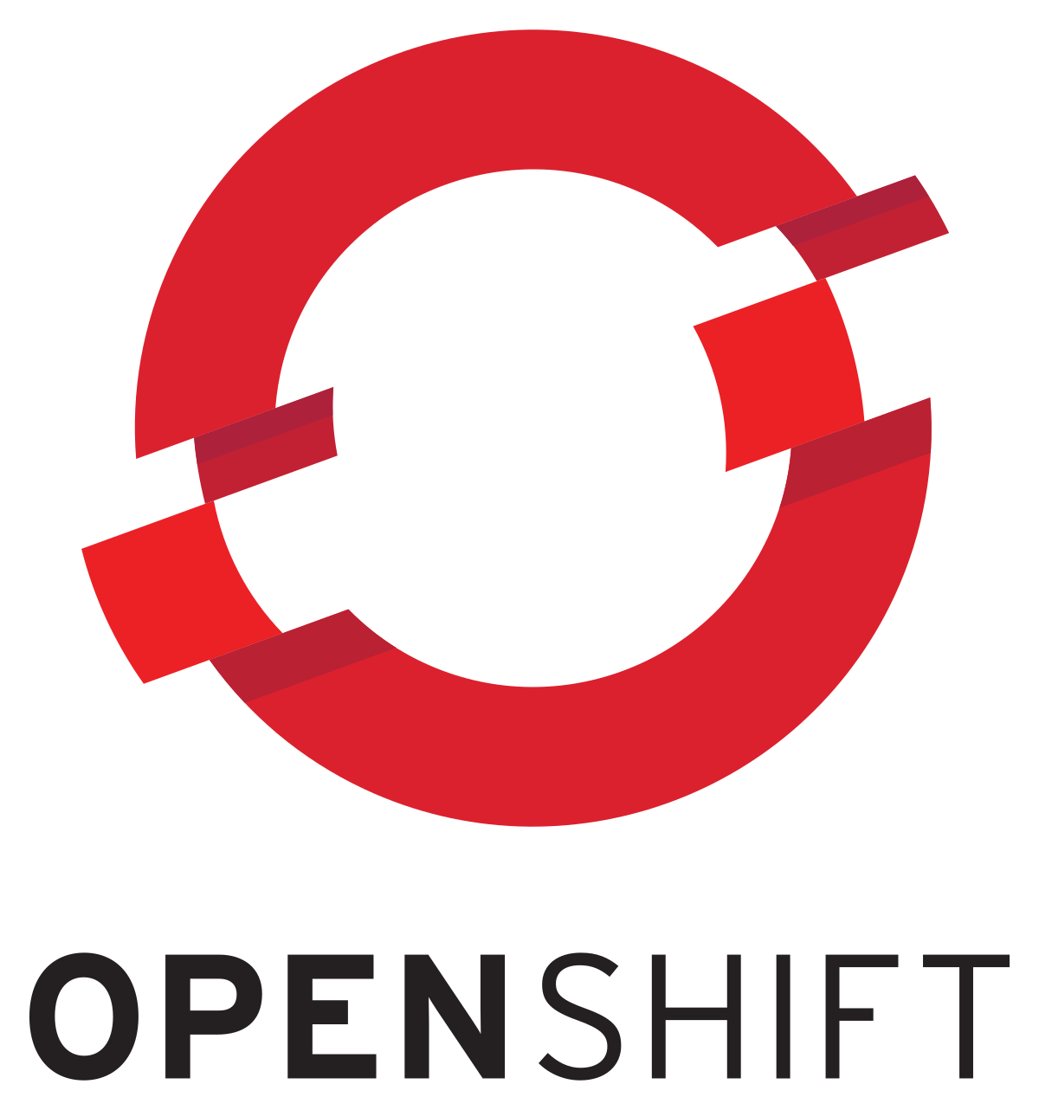


Underpinned by the Cognizant Intelligent Engineering – Modernize⁺ suite
Cognizant Intelligent Engineering | Modernize⁺
C-MAP
C-CAP
Digital Engineering Platform
Enterprise Modernization Strategy
Engineering ‘Modernization’
Industrialized and insights driven approach for Strategizing modernization
Automated Discovery, Portfolio analysis and execution planning for Modernization Strategy
Contextual Solution recommendations using Modernization Acceleration Kits for accelerated execution
Value realization and Progress Dashboards for effective Governance
An intelligent acceleration platform for application cloud transformation
Provides semi-automated blueprints for faster and smarter application transformation
Provides the ability to automatically transform the codebase of the applications identified as re-host and re-platform candidates
Leveraging a Niche + Hyper-scale Partner Ecosystem
Orchestrated through Cognizant Intelligent Engineering | Modernize+
Notes:
Modernization Points –
Cloud based modernization including cloud native development are the biggest bets today and growing at 22.8% CAGR
Today, 76% of North American and European enterprise decision makers consider migrating existing apps to the cloud as part of their cloud strategy - Forrester
By 2023, application services spending driven by digital requirements will account for 65% of the overall application services market, up from 30% in 2018 - Gartner
By 2021, 65% of CIOs will expand agile/DevOps practices into the wider business to achieve the velocity necessary for innovation, execution, and change – IDC
By 2023, 40% of application modernization work will be contracted under a multiyear AMS deal - Gartner

Slide 7










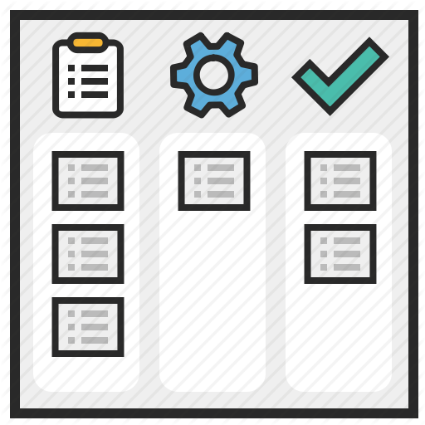

Strategizing Modernization through Cognizant Modernization Acceleration Platform (C-MAP) erstwhile OneModernize Platform
Automated Discovery and Planning of Modernization opportunities
Contain
Re host
Refactor
Application & Infra Discovery
Portfolio Analysis
Maintain
Reengineer
Retire
Encapsulate
Application Categorization
Treatment Strategy
Re platform
Re architect
Invest
Execution Planning
Sprint Backlog
Grouping of Application by Technology and Service
Sprint Planning
Opportunity BoW
Accelerated execution - Modernization Acceleration Kit (MAK) Recommendation
Solution Blueprint Configuration
Solution Blueprint Customization
Solution Blueprint Recommendation
Selection of blue print based on Grouping
Contextualization based on Constraints
Solution Blueprint package Download kit
Solution Kit
Modernization Governance
Governance Dashboard
Sprint planning tool
Sprint progress data
Modernization progress review

Slide 8

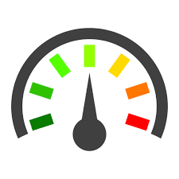
Engineering Modernization through C-CAP
Automate and Scale application cloud transformation with C-CAP
Cloud Readiness Assessment
From On-prem to target cloud
From one cloud platform to other cloud platform (PCF to OpenShift, Azure to GKE)
Business Rule Extraction
Automated BRE Solution
Accurate alignment of business functions
Insights and Application Cloud readiness dashboard
Accelerated migration
Transformation Recipes
Remediation Templates
Service Templates
Data Lineage Acceleration
Lineage across Multi-Technology
Customized reports
Data Governance
Application Fault Vulnerability Assessment
Accelerate Microservice Development
Legacy to cloud acceleration
Plugin integration
C-CAP is an Intelligent Cloud Acceleration Platform for Application Cloud Transformation and Greenfield Application Development. It provides one click automation of cloud readiness assessment and automates steps for transformation & deployment. It provides in-depth inventory analysis of mainframe code repository. It also provides Cloud readiness dashboard and the reliability risk score of the applications.

Slide 9


Application Modernization | Sub-offerings overview
Application led Cloud Migration
Legacy Modernization
Modernize through an application led approach to cloud migration, making them digital ready and ensure agility, scalability at a low cost
Modernizing Legacy applications and its eco system to a cost effective modern platform
Tech Stack Modernization
Business Led Modernization**
Cost effective technology upgrade and migration of applications to the enterprise prescribed currency levels
Modernizing Business processes with the help of a data driven approach
** Pipeline Service
Orchestrated through Cognizant Intelligent Engineering | Modernize⁺

Slide 10
Application Led Cloud Migration

Slide 11
AWS MAP 2.0

Slide 12
2022 Cognizant AWS: MAP 2.0 Partner Funding
ASSESS
MOBILIZE
MIGRATE & MODERNIZE
Large Migrations
MAP $500K+ ARR
Up to $60K USD cash for AWS Partner delivered Assessment
$1:$1 match on the cost of the Mobilize Project Plan, up to 40% of post migration ARR (max of $400K) in cash
Up to 25% of post migration ARR in cash or credits
MAP Lite <$500K ARR
MAP Lite Assess & Mobilize ARR: $250K - $500K
Up to 15% of post migration ARR in cash or credits
Up to $15K USD cash for AWS Partner delivered Assessment
$1:$1 match of the cost of the Mobilize Project, up to 20% of post migration ARR in cash
Note:
MAP Lite Migrate & Modernize Funding is not subject to $250K annual recurring revenue (ARR) minimum requirement.
MAP Partner Cash is capped at the cost of the SOW/Project Plan for the Assess, and Migrate & Modernize Phase

Slide 13
2022 Cognizant AWS: Migrate & Modernize Phase Benefits
SAP
BY WORKLOAD, NO MINIMUM ARR REQUIREMENT.
+50%
Of incremental ARR from SAP^{3,4}
From Commercial DB
+25%
Of incremental ARR from eligible DB&A Services²
From Non-Commercial DB
Windows workloads
Of incremental ARR from eligible DB&A Services²
+10%
+5%
Of incremental Windows ARR¹
BY CUSTOMER SEGMENT
Specialized incentives may be subject to AWS Partner Use Case / Workload Competency or Service Delivery Designation for all deal sizes
Private Equity
+10%
Of incremental ARR for select Private Equity backed customers²
¹ Available if an Optimization and Licensing Assessment is completed
² Commercial is defined as: any third-party database engine, data warehouse, or analytics offering for which you have paid a fee for use rights, enhancements, maintenance, or support for that third party offering.
³ PE migrate & SAP cannot be combined with additional workload incentives
⁴ SAP workloads are SAP on premise software packages that are operated in the customer, solution provider, or distributor account on AWS

Slide 14
2022 Cognizant AWS: Application Migration Methodology
ASSESS
MOBILIZE
MIGRATE & MODERNIZE
Migration Evaluator
Rapid migration business case (RMBC)
Migrate
Discovery and planning
Business case
Migration
plan
Landing Zone
Rapid discovery
TCO report
Migration Readiness Assessment
Operate
Briefings & workshops
Immersion day
Security & compliance
Operating model
Migration experience
Skills / center of excellence
Modernize
Create a case for change
Mobilization through experiences
Accelerate migration at scale

Slide 15
T&H Top Modernization Trends on AWS
Personalization
True personalization with accurate customer data, third party data can be obtained through AWS Data Exchange
Recommendation Engine
Customer Experience
Wynn Las Vegas is using Alexa Smart Properties for Hospitality to empower guests to control lights, curtains, temperature, room service
Text to Order is picking up with Gen Z
Customer Contact Center
Many Hotel Owners investing in Customer Contact Center leveraging AWS Services
Amazon Connect and Amazon Lex
Best Western 40% Cost Savings
Hilton Hotels and Resorts Lex Chatbots
Computer Vision
Automatic recognition and description of images and video
Notes:
Customer Data Platform from AWS T&H Hospitality Competency partners like Amperty, mparticle, Reltio or Tealium
Computer Vision on AWS - Amazon Rekognition

